Slide 1
e-Desk
All your solutions in one platform

Slide 2
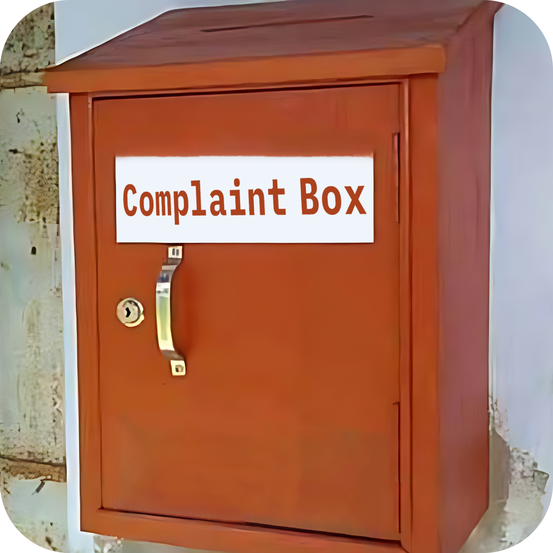
Current Problems
Complexities of Complaints,
Suggestions and Applications
Lack of Transparency and Accountability
Uncertainty in keeping records
Documentation of processes on paper

Slide 3
At A Glance
8
38
22
20-30
Departments
Offices
Faculties
and Institutes
Clubs
and Societies
Source: www.jnu.ac.bd

Slide 4

Our Solution
Grievances submission for authorized users
Office-specific grievance submission
Efficient monitoring and decision-making
Digital records for each submission
Immediate authority responses

Slide 5
System Overview
add and manage offices
approve and manage users
Admin can
approve and manage posts
monitor the Complaints, Suggestions, Applications and take necessary steps
e-Desk
comment on the posts
submit Complaints
User can
give Suggestions
submit Applications
see the current status of Grievances

Slide 6
Tools and Technologies
Front-End
Back-End
HTML, CSS, JavaScript
PHP
Database
Tools
MySQL, Azure Cloud
Visual Studio Code, XAMPP, Azure Data Studio

Slide 7
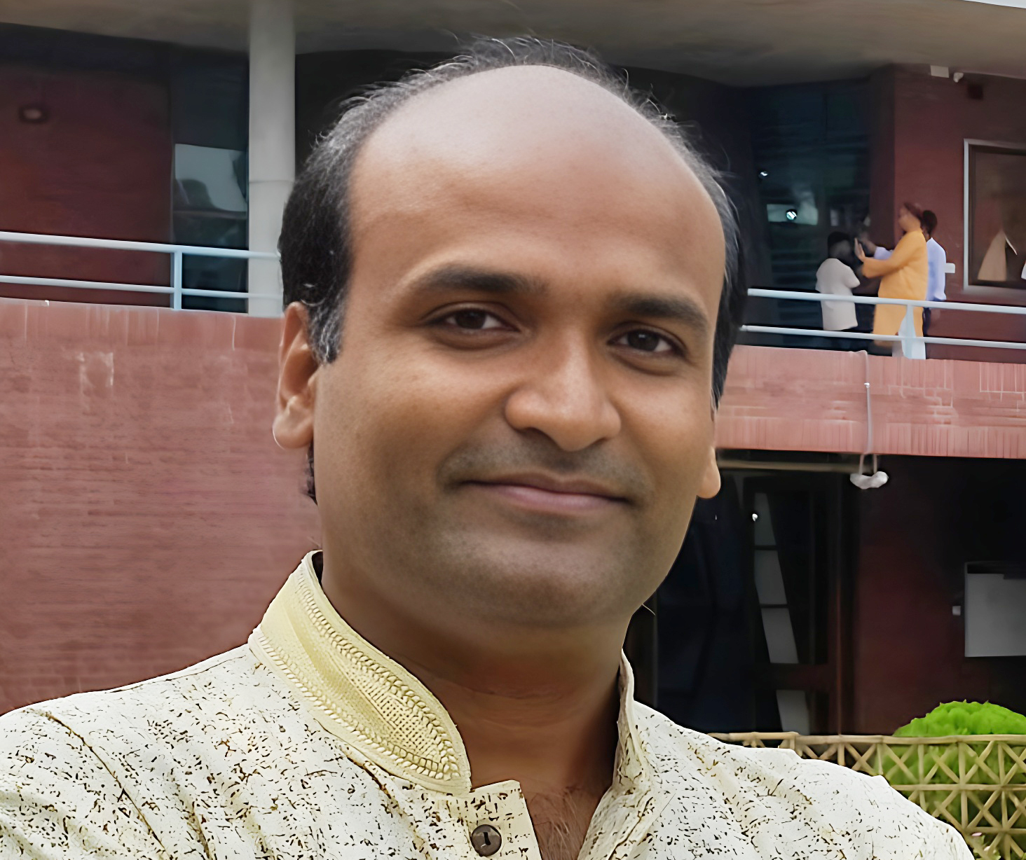

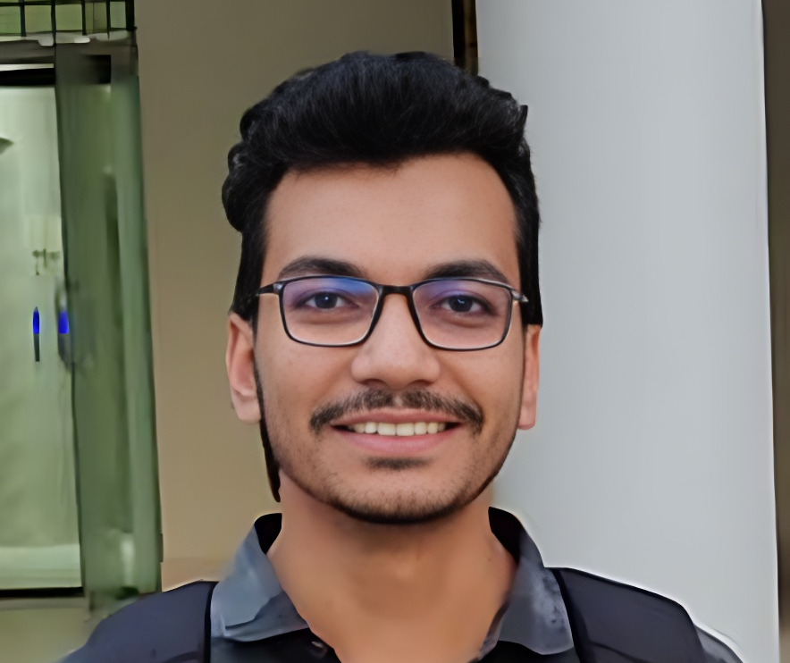
Internet and Web Programming (Project) Course Code: CSE-3109
Dr. Sajeeb Saha
Course Instructor
Associate Professor,
Dept. of CSE, JnU
Nishat Mahmud
Md. Waliul Islam Rayhan
B190305003
B190305034

Slide 8

Thank You

Slide 9

Image always reinforce
the concept
You can give a brief description of the topic you want to talk about here. For example, if you want to talk about Mercury, you can say that it’s the smallest planet in the entire Solar System

Slide 10
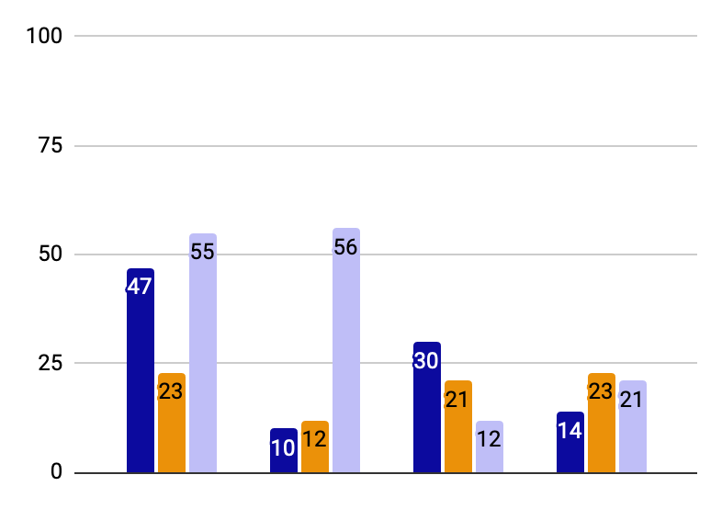
You can use this graph
Mercury
Mercury is the closest planet to the Sun
Jupiter
Jupiter is the biggest planet of them all
Saturn
Saturn was named after a Roman god
Follow the link in the graph to modify its data and then paste the new one here. For more info, click here

Slide 11
Mockups
You can replace the images on the screen with your own work. Just right-click on them and select “Replace image”

Slide 12
Thanks!
Do you have any questions?
youremail@freepik.com
+34 654 321 432
yourwebsite.com
Please keep this slide for attribution

Slide 13
Use our editable graphic resources...
You can easily resize these resources without losing quality. To change the color, just ungroup the resource and click on the object you want to change. Then, click on the paint bucket and select the color you want. Group the resource again when you’re done. You can also look for more infographics on Slidesgo.

